Slide 1
Bitwise Operations
CS580U – Spring 2019

Slide 2
What is Binary
Recall - Every thing in a computer is binary
Text
images
video
this slide lecture

Slide 3
Why Binary?
Why do computers use binary?
Why not base 10?
Why do we use a decimal system?

Slide 4
Counting Binary
Computers are built out of switches with two states
On
Off
Computers only have two fingers

Slide 5
How Does Binary Work?
Base 2
0 and 1
2 (in base 10) == 10 (in base 2)
Binary Powers of two:
1 | 2 | 4 | 8 | 16 | 32 | 64 | 128
0000 0001 | 0000 0010 | 0000 0100 | 0000 1000 | 0001 0000 | 0010 0000 | 0100 0000 | 1000 0000

Slide 6
Translate from Binary to Decimal
Each place is a power of two
Just like each place in decimal is a power of ten
1000, 100, 10, 1
Count the places, and add them up
8, 4, 2, 1
1010 = 1*2³ + 0*2² + 0*2² + 1*2⁰
8 + 2 = 10

Slide 7
Negative Numbers
How do we get negative numbers from binary?
Computers don’t have signs
Term: Most Significant Bit
Last bit in the data type
32nd bit in 32 bit data type
16th bit in 16 bit data type

Slide 8
1's Complement
How can we get negative numbers from binary?
Reserve the last bit as a signed bit, then flip the bits for negative numbers
1111 1110 -> (flip the bits) 0000 0001 -> (make it negative) -1
But what about this?
1111 1111 = -0

Slide 9
2’s Complement
Same procedure as 1’s complement
After conversion to negative, add 1
This gets rid of negative zero
Example:
1111 1111 -> (flip the bits) 0000 0000 -> (add 1) 0000 0001 -> (make it negative) -1

Slide 10
Signed Numbers
Takeaway:
Signed numbers are signed by their most significant bit
1 for negative, 0 for positive
2’s complement eliminates the negative zero problem

Slide 11
21
24
38
254
-3
6
-1
3
Classwork: Binary

Slide 12
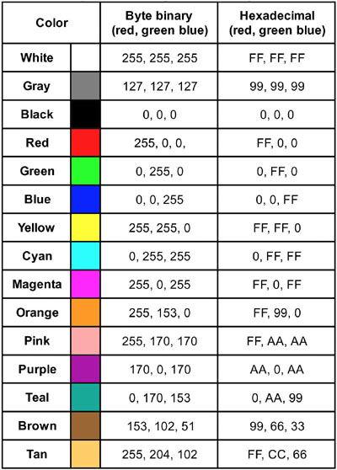
Low Level Bit Operations
C allows bit-level operations
Used extensively in binary representation of colors

Slide 13
Bitwise Operators
& - AND
| - OR
^ - XOR
~ - 1’s Compliment
<< - Left Shift
>> - Right Shift

Slide 14
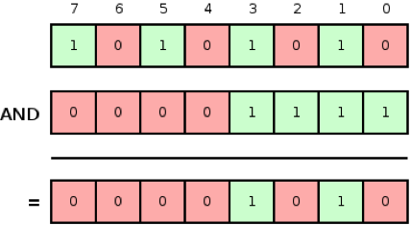
AND two bit values - &
Two bits and-ed together result in a 1 if both are 1, otherwise the result is 0
Op1 | Op2 | Result
1 | 1 | 1
1 | 0 | 0
0 | 0 | 0

Slide 15
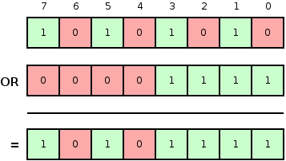
OR two bit values - |
Two bits or-ed together result in a 1 if one or both are 1, otherwise the result is 0
Op1 | Op2 | Result
1 | 1 | 1
1 | 0 | 1
0 | 0 | 0

Slide 16
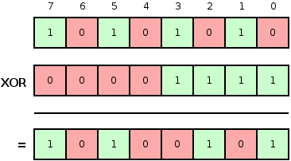
XOR two bit values - ^
Two bits xor-ed together result in a 1 only if one bit is 1, otherwise the result is 0
Op1 | Op2 | Result
1 | 1 | 0
1 | 0 | 1
0 | 0 | 0

Slide 17
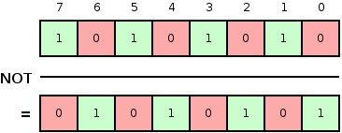
1’s Complement a bit value - ~
Inverts the bits in a value
Op1 | Result
1 | 0
0 | 1

Slide 18
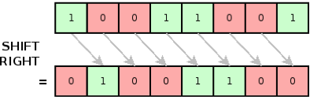
Right Shift bit values - >>
Bits are shifted right by operand 2 number of places, dropping the bits
Op1 | Op2 | Result
11 | 1 | 1
01 | 1 | 0
10 | 2 | 0

Slide 19
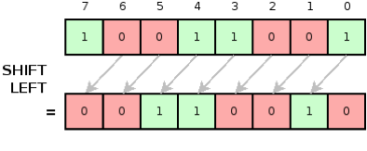
Left Shift bit values - <<
Bits are shifted left by operand 2 number of places, adding zeros
Op1 | Op2 | Result
11 | 1 | 110
01 | 1 | 010
10 | 2 | 1000

Slide 20
Classwork: Logical Operations

